Slide 1
Lecture Title: Introduction & Preliminary Discussions on Algorithms [Part-2]
Course Code: CSC 2211
Course Title: Algorithms
Dept. of Computer Science
Faculty of Science and Technology
Lecture No: | 01 | Week No: | 01 | Semester:
Lecturer: | Name: Mushfiqur Rahman; E-mail: mushfiqur@aiub.edu

Slide 2
Insertion sort
Steps:
Declare the first element of the array “sorted”. (This will divide the array into 2 portions: sorted and unsorted)
Repeat until all elements are sorted:
Look at the first unsorted element (let’s call it e). Insert e into the sorted portion by shifting the required number of elements (this is done by comparing e with the element(s) in the sorted portion).

Slide 3
Insertion sort (cont.)
Ascending Order
5
2
1
3
6
4
Steps:
Declare the first element of the array “sorted”. (This will divide the array into 2 portions: sorted and unsorted)
Repeat until all elements are sorted:
Look at the first unsorted element (let’s call it e). Insert e into the sorted portion by shifting the required number of elements (this is done by comparing e with each element in the sorted portion).

Slide 4
Insertion sort (cont.)
Ascending Order
2 < 5
True
5
2
1
3
6
4
Steps:
Declare the first element of the array “sorted”. (This will divide the array into 2 portions: sorted and unsorted)
Repeat until all elements are sorted:
Look at the first unsorted element (let’s call it e). Insert e into the sorted portion by shifting the required number of elements (this is done by comparing e with each element in the sorted portion).

Slide 5
Insertion sort (cont.)
Ascending Order
2
5
1
3
6
4
copy
Steps:
Declare the first element of the array “sorted”. (This will divide the array into 2 portions: sorted and unsorted)
Repeat until all elements are sorted:
Look at the first unsorted element (let’s call it e). Insert e into the sorted portion by shifting the required number of elements (this is done by comparing e with each element in the sorted portion).

Slide 6
Insertion sort (cont.)
Ascending Order
substitute
2
5
5
1
3
6
4
Steps:
Declare the first element of the array “sorted”. (This will divide the array into 2 portions: sorted and unsorted)
Repeat until all elements are sorted:
Look at the first unsorted element (let’s call it e). Insert e into the sorted portion by shifting the required number of elements (this is done by comparing e with each element in the sorted portion).

Slide 7
Insertion sort (cont.)
Ascending Order
1 < 5
True
2
5
1
3
6
4
Steps:
Declare the first element of the array “sorted”. (This will divide the array into 2 portions: sorted and unsorted)
Repeat until all elements are sorted:
Look at the first unsorted element (let’s call it e). Insert e into the sorted portion by shifting the required number of elements (this is done by comparing e with each element in the sorted portion).

Slide 8
Insertion sort (cont.)
Ascending Order
1
2
5
3
6
4
copy
Steps:
Declare the first element of the array “sorted”. (This will divide the array into 2 portions: sorted and unsorted)
Repeat until all elements are sorted:
Look at the first unsorted element (let’s call it e). Insert e into the sorted portion by shifting the required number of elements (this is done by comparing e with each element in the sorted portion).

Slide 9
Insertion sort (cont.)
Ascending Order
1 < 2
True
1
2
5
5
3
6
4
copy
Steps:
Declare the first element of the array “sorted”. (This will divide the array into 2 portions: sorted and unsorted)
Repeat until all elements are sorted:
Look at the first unsorted element (let’s call it e). Insert e into the sorted portion by shifting the required number of elements (this is done by comparing e with each element in the sorted portion).

Slide 10
Insertion sort (cont.)
Ascending Order
substitute
1
2
2
5
3
6
4
Steps:
Declare the first element of the array “sorted”. (This will divide the array into 2 portions: sorted and unsorted)
Repeat until all elements are sorted:
Look at the first unsorted element (let’s call it e). Insert e into the sorted portion by shifting the required number of elements (this is done by comparing e with each element in the sorted portion).

Slide 11
Insertion sort (cont.)
Ascending Order
3 < 5
True
1
2
5
3
6
4
Steps:
Declare the first element of the array “sorted”. (This will divide the array into 2 portions: sorted and unsorted)
Repeat until all elements are sorted:
Look at the first unsorted element (let’s call it e). Insert e into the sorted portion by shifting the required number of elements (this is done by comparing e with each element in the sorted portion).

Slide 12
Insertion sort (cont.)
Ascending Order
3
1
2
5
6
4
copy
Steps:
Declare the first element of the array “sorted”. (This will divide the array into 2 portions: sorted and unsorted)
Repeat until all elements are sorted:
Look at the first unsorted element (let’s call it e). Insert e into the sorted portion by shifting the required number of elements (this is done by comparing e with each element in the sorted portion).

Slide 13
Insertion sort (cont.)
Ascending Order
3 < 2
False
3
1
2
5
5
6
4
Steps:
Declare the first element of the array “sorted”. (This will divide the array into 2 portions: sorted and unsorted)
Repeat until all elements are sorted:
Look at the first unsorted element (let’s call it e). Insert e into the sorted portion by shifting the required number of elements (this is done by comparing e with each element in the sorted portion).

Slide 14
Insertion sort (cont.)
Ascending Order
substitute
3
1
2
5
5
6
4
Steps:
Declare the first element of the array “sorted”. (This will divide the array into 2 portions: sorted and unsorted)
Repeat until all elements are sorted:
Look at the first unsorted element (let’s call it e). Insert e into the sorted portion by shifting the required number of elements (this is done by comparing e with each element in the sorted portion).

Slide 15
Insertion sort (cont.)
Ascending Order
6 < 5
False
1
2
3
5
6
4
Steps:
Declare the first element of the array “sorted”. (This will divide the array into 2 portions: sorted and unsorted)
Repeat until all elements are sorted:
Look at the first unsorted element (let’s call it e). Insert e into the sorted portion by shifting the required number of elements (this is done by comparing e with each element in the sorted portion).

Slide 16
Insertion sort (cont.)
Ascending Order
6
1
2
3
5
4
Steps:
Declare the first element of the array “sorted”. (This will divide the array into 2 portions: sorted and unsorted)
Repeat until all elements are sorted:
Look at the first unsorted element (let’s call it e). Insert e into the sorted portion by shifting the required number of elements (this is done by comparing e with each element in the sorted portion).

Slide 17
Insertion sort (cont.)
Ascending Order
4 < 6
True
1
2
3
5
6
4
Steps:
Declare the first element of the array “sorted”. (This will divide the array into 2 portions: sorted and unsorted)
Repeat until all elements are sorted:
Look at the first unsorted element (let’s call it e). Insert e into the sorted portion by shifting the required number of elements (this is done by comparing e with each element in the sorted portion).

Slide 18
Insertion sort (cont.)
Ascending Order
4
1
2
3
5
6
copy
Steps:
Declare the first element of the array “sorted”. (This will divide the array into 2 portions: sorted and unsorted)
Repeat until all elements are sorted:
Look at the first unsorted element (let’s call it e). Insert e into the sorted portion by shifting the required number of elements (this is done by comparing e with each element in the sorted portion).

Slide 19
Insertion sort (cont.)
Ascending Order
4 < 5
True
4
1
2
3
5
6
6
copy
Steps:
Declare the first element of the array “sorted”. (This will divide the array into 2 portions: sorted and unsorted)
Repeat until all elements are sorted:
Look at the first unsorted element (let’s call it e). Insert e into the sorted portion by shifting the required number of elements (this is done by comparing e with each element in the sorted portion).

Slide 20
Insertion sort (cont.)
Ascending Order
4 < 3
False
substitute
4
1
2
3
5
5
6
Steps:
Declare the first element of the array “sorted”. (This will divide the array into 2 portions: sorted and unsorted)
Repeat until all elements are sorted:
Look at the first unsorted element (let’s call it e). Insert e into the sorted portion by shifting the required number of elements (this is done by comparing e with each element in the sorted portion).

Slide 21
Insertion sort (cont.)
Ascending Order
SORTED
1
2
3
4
5
6
Steps:
Declare the first element of the array “sorted”. (This will divide the array into 2 portions: sorted and unsorted)
Repeat until all elements are sorted:
Look at the first unsorted element (let’s call it e). Insert e into the sorted portion by shifting the required number of elements (this is done by comparing e with each element in the sorted portion).

Slide 22
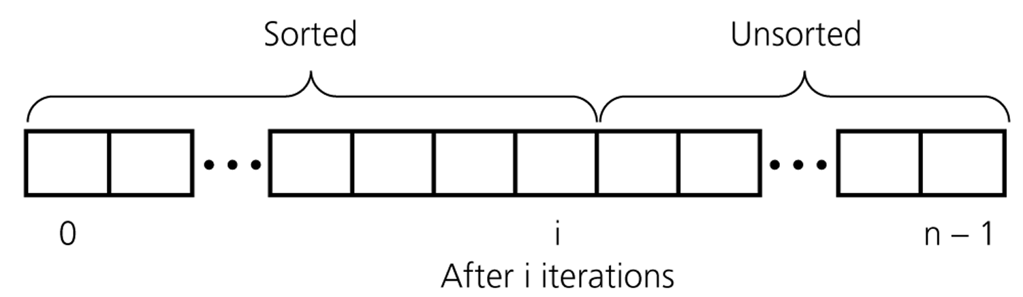
An insertion sort partitions the array into two regions

Slide 23
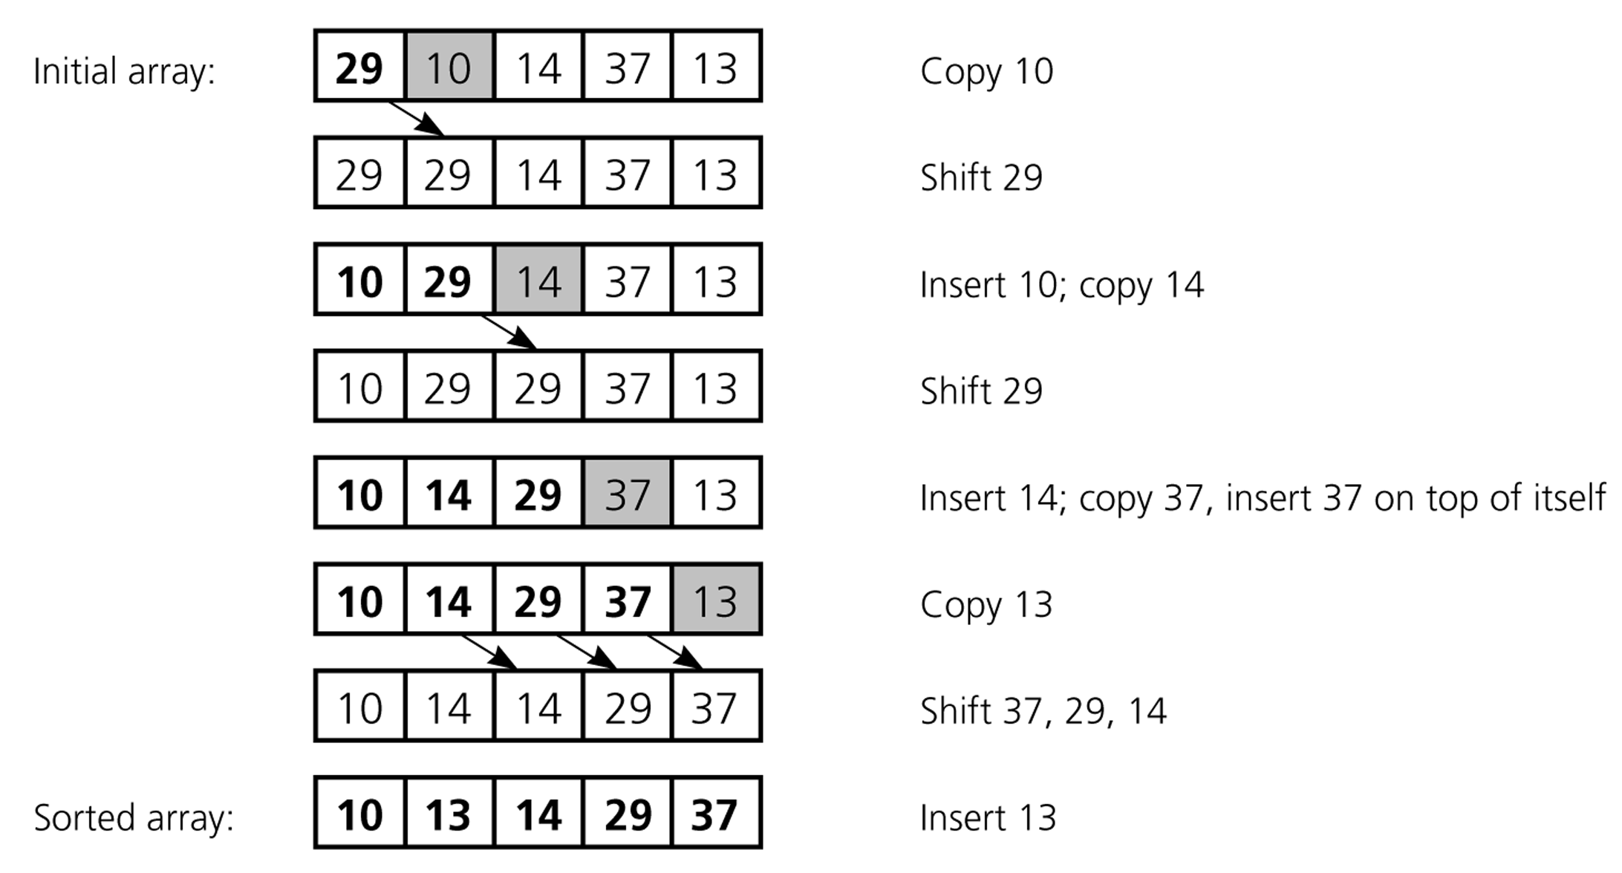
An insertion sort of an array of five integers

Slide 24
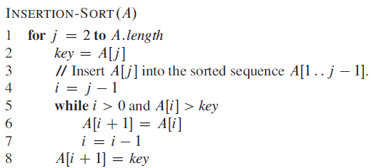
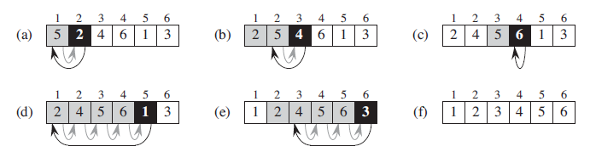
Insertion Sort

Slide 25
Analysis of Insertion Sort
Time to compute the running time as a function of the input size (exact analysis).
for j := 2 to n do
key := A[j]
// Insert A[j] into A[1..j-1]
i := j-1
while i>0 and A[i]>key do
A[i+1]:=A[i]
i--
A[i+1]:=key
cost c₁
c₂
0
c₃
c₄
c₅
c₆
c₇
times n n-1 n-1 n-1 n-1

Slide 26
…Analysis of Insertion Sort
The running time of an algorithm is the sum of the running times of each statement.
A statement with cost c that is executed n times contributes c*n to the running time.
The total running time T(n) of insertion sort is
T(n)= c₁*n + c₂(n-1) + c₃(n-1) + c₄ + c₅ + c₆
+ c₇ (n-1)

Slide 27
…Analysis of Insertion Sort
Often the performance depends on the details of the input (not only the length n).
This is modeled by t_{j.}
In the case of insertion sort the time t_{j} depends on the original sorting of the input array.

Slide 28
Performance Analysis
Performance often draws the line between what is feasible and what is impossible.
Often it is sufficient to count the number of iterations of the core (innermost) part.
No distinction between comparisons, assignments, etc (that means roughly the same cost for all of them).
Gives precise enough results.
In some cases the cost of selected operations dominates all other costs.
Disk I/O versus RAM operations.
Database systems.

Slide 29
Best/ Worst/ Average Case [insertion Sort]
Best case: works fast on some input.
Worst case: (usually) maximum time of algorithm on any input of size.
Average case: (sometimes) expected time of algorithm over all inputs of size. Need assumption of statistical distribution of inputs.
Analyzing insertion sort’s
Best case: elements already sorted, t_{j}=1.
Worst case: elements are sorted in inverse order, t_{j} = j.
Average case: elements are half-way sorted t_{j} = j / 2.

Slide 30
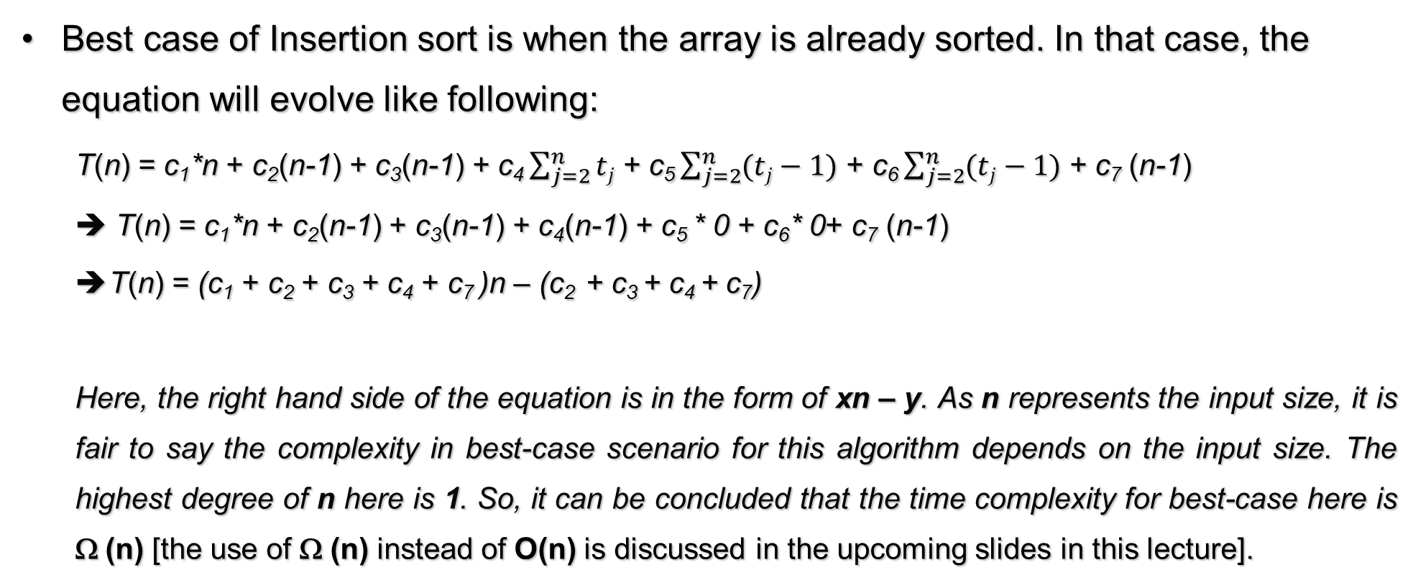
Best-case [Insertion Sort]
Best case of Insertion sort is when the array is already sorted. In that case, the equation will evolve like following:
T(n) = c₁*n + c₂(n-1) + c₃(n-1) + c₄ $\sum_{j=2}^{n}{tj}$ + c₅ $\sum_{j=2}^{n}{(tj−1)}$ + c₆ $\sum_{j=2}^{n}{(tj−1)}$ + c₇ (n-1)
➔ T(n) = c₁*n + c₂(n-1) + c₃(n-1) + c₄(n-1) + c₅ * 0 + c₆* 0+ c₇ (n-1)
T(n) = (c₁ + c₂ + c₃ + c₄ + c₇ )n – (c₂ + c₃ + c₄ + c₇)
Here, the right hand side of the equation is in the form of xn – y. As n represents the input size, it is fair to say the complexity in best-case scenario for this algorithm depends on the input size. The highest degree of n here is 1. So, it can be concluded that the time complexity for best-case here is Ω (n) [the use of Ω (n) instead of O(n) is discussed in the upcoming slides in this lecture].

Slide 31
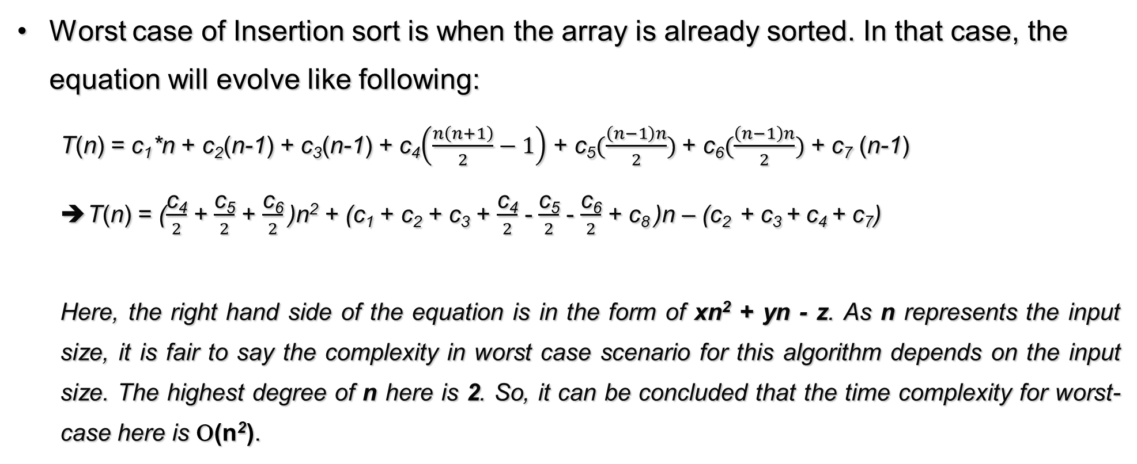
Worst-case [Insertion Sort]
Worst case of Insertion sort is when the array is already sorted. In that case, the equation will evolve like following:
T(n) = c₁*n + c₂(n-1) + c₃(n-1) + c₄$\left(\frac{n\left(n+1\right)}{2}−1\right)$ + c₅$(\frac{\left(n−1\right)n}{2})$ + c₆$(\frac{\left(n−1\right)n}{2})$ + c₇ (n-1)
T(n) = ($\frac{\text{c}\text{4}}{2}$ + $\frac{\text{c}\text{5}}{2}$ + $\frac{\text{c}\text{6}}{2}$ )n² + (c₁ + c₂ + c₃ + $\frac{\text{c}\text{4}}{2}$ - $\frac{\text{c}\text{5}}{2}$ - $\frac{\text{c}\text{6}}{2}$ + c₈ )n – (c₂ + c₃ + c₄ + c₇)
Here, the right hand side of the equation is in the form of xn² + yn - z. As n represents the input size, it is fair to say the complexity in worst case scenario for this algorithm depends on the input size. The highest degree of n here is 2. So, it can be concluded that the time complexity for worst-case here is Ο(n²).

Slide 32
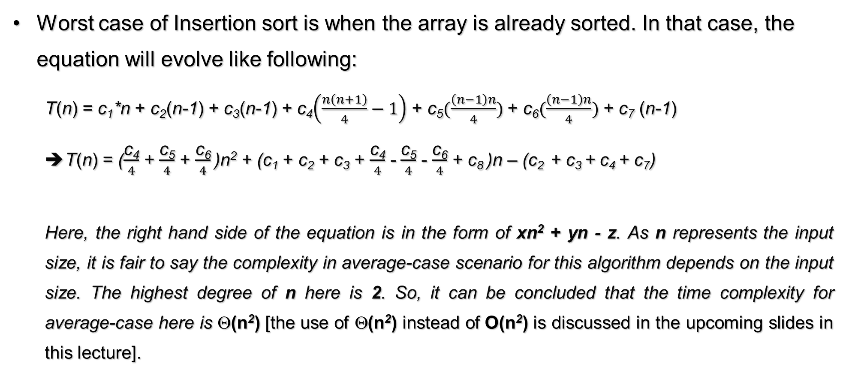
Average-case [Insertion Sort]
Worst case of Insertion sort is when the array is already sorted. In that case, the equation will evolve like following:
T(n) = c₁*n + c₂(n-1) + c₃(n-1) + c₄$\left(\frac{n\left(n+1\right)}{4}−1\right)$ + c₅$(\frac{\left(n−1\right)n}{4})$ + c₆$(\frac{\left(n−1\right)n}{4})$ + c₇ (n-1)
T(n) = ($\frac{\text{c}\text{4}}{4}$ + $\frac{\text{c}\text{5}}{4}$ + $\frac{\text{c}\text{6}}{4}$ )n² + (c₁ + c₂ + c₃ + $\frac{\text{c}\text{4}}{4}$ - $\frac{\text{c}\text{5}}{4}$ - $\frac{\text{c}\text{6}}{4}$ + c₈ )n – (c₂ + c₃ + c₄ + c₇)
Here, the right hand side of the equation is in the form of xn² + yn - z. As n represents the input size, it is fair to say the complexity in average-case scenario for this algorithm depends on the input size. The highest degree of n here is 2. So, it can be concluded that the time complexity for average-case here is Θ(n²) [the use of Θ(n²) instead of O(n²) is discussed in the upcoming slides in this lecture].

Slide 33
Best/ Worst/ Average Case
Worst case is usually used to describe complexity of an algorithm in general:
It is an upper-bound.
In certain application domains (e.g., air traffic control, surgery) knowing the worst-case time complexity is of crucial importance.
For some algorithms worst case occurs fairly often
The average case is often as bad as the worst case.
Finding the average case can be very difficult.

Slide 34
Asymptotic Notation
Asymptotic Notations are languages that allow us to analyze an algorithm's running time by identifying its behavior as the input size for the algorithm increases.
This is also known as an algorithm's growth rate.(Wiki)

Slide 35
Asymptotic Notation
The “big-Oh” O-Notation
asymptotic upper bound
Used for worst-case analysis

Slide 36
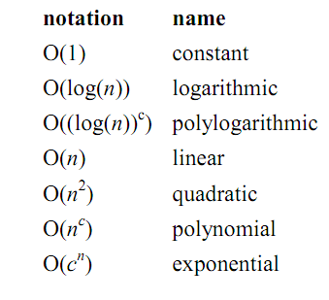
Asymptotic Notation

Slide 37
...Asymptotic Notation
The “big-Omega” Ω−Notation
asymptotic lower bound
Used to describe best-case running times or lower bounds of algorithmic problems.

Slide 38
...Asymptotic Notation
The “big-Theta” Θ−Notation
asymptoticly tight bound
Used for Average-case analysis
O(_) is often abused instead of Θ(_)

Slide 39
Asymptotic Analysis
Goal: to simplify the analysis of the running time by getting rid of details, which are affected by specific implementation and hardware
rounding of numbers: 1,000,001 ≈ 1,000,000
rounding of functions: 3n² ≈ n²
Capturing the essence: how the running time of an algorithm increases with the size of the input in the limit.
Asymptotically more efficient algorithms are best for all but small inputs

Slide 40
...Asymptotic Analysis
Simple Rule: Drop lower order terms and constant factors.
50 n log n is O(n log n)
7n - 3 is O(n)
8n² log n + 5n² + n is O(n² log n)
Note: Although (50 n log n) is O(n⁵), it is expected that an approximation is of the smallest possible order.

Slide 41
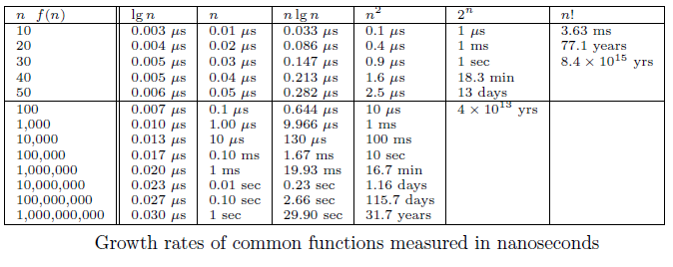
Growth Rates and Dominance Relations

Slide 42
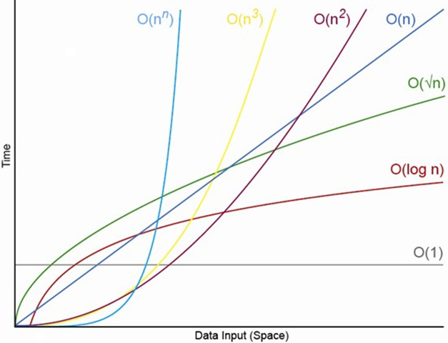
Order of Complexity Visualized

Slide 43
Correctness of Algorithms
An algorithm is correct if for any legal input it terminates and produces the desired output.
Automatic proof of correctness is not possible (so far).
There are practical techniques and rigorous formalisms that help to reason about the correctness of (parts of) algorithms.

Slide 44
Partial and Total Correctness
Partial correctness
IF this point is reached,
THEN this is the desired output
Any legal input
Algorithm
Output
Total correctness
INDEED this point is reached,
AND this is the desired output
Any legal input
Algorithm
Output

Slide 45
Sorting
Sorting is a classical and important algorithmic problem.
We look at sorting arrays (in contrast to files, which restrict random access).
A key constraint is the efficient management of the space
In-place sorting algorithms
The efficiency comparison is based on the number of comparisons (C) and the number of movements (M).

Slide 46
Sorting
Simple sorting methods:
Insertion sort
Selection sort
Bubble sort
Fast sorting methods:
Merge sort
Counting Sort
Quicksort
Done!
Homework. Find out the Worst case and Best case scenarios and time complexity.
TO BE COVERED NEXT!

Slide 47
References & Readings
CLRS
Chapters: 1, 2 (2.1, 2.2), 3
Exercises: 1.2-2, 1.2-3, 2.1-3, 2.1-4, 2.2-1, 2.2-3, 3.1-1, 3.1-4, 3.1-6, 3.1
Problems: 1-1, 3-3
HSR
Chapters: 1 (1.1-1.3)
Examples: 1.4-1.6, 1.11-1.13, 1.17-1.18
Exercises: 1.3 (1-4, 8, 9)
Review for laboratory
HSR
Chapters: 2, 3.2 - 3.5
CLRS
Chapters: 6, 7, 10, 12

